Slide 1
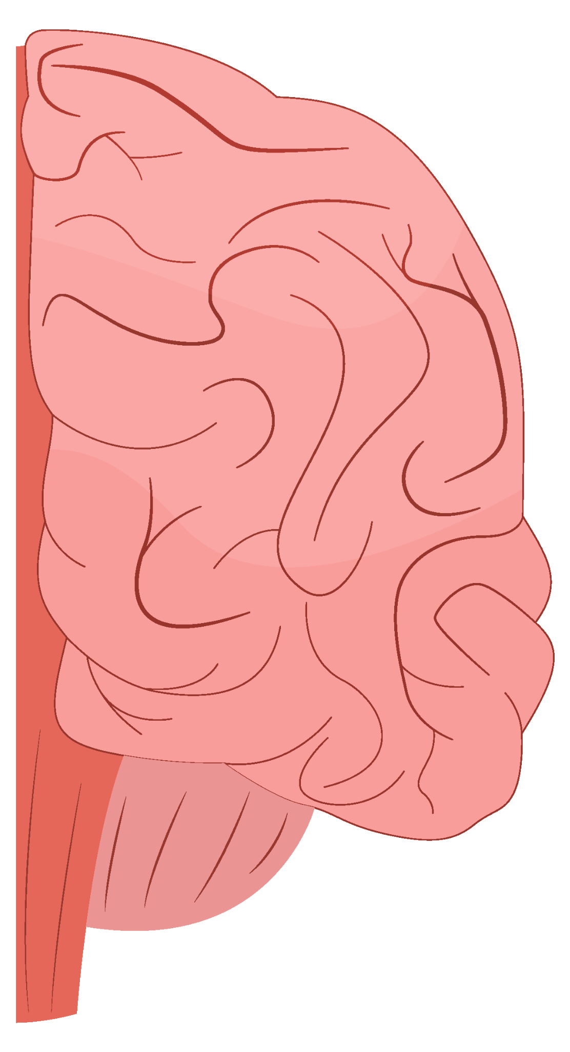
Dementia Prediction Model Project 4
Contributors:
Hansle Goh, Dumiduni Geeganage, Noelle Watson

Slide 2
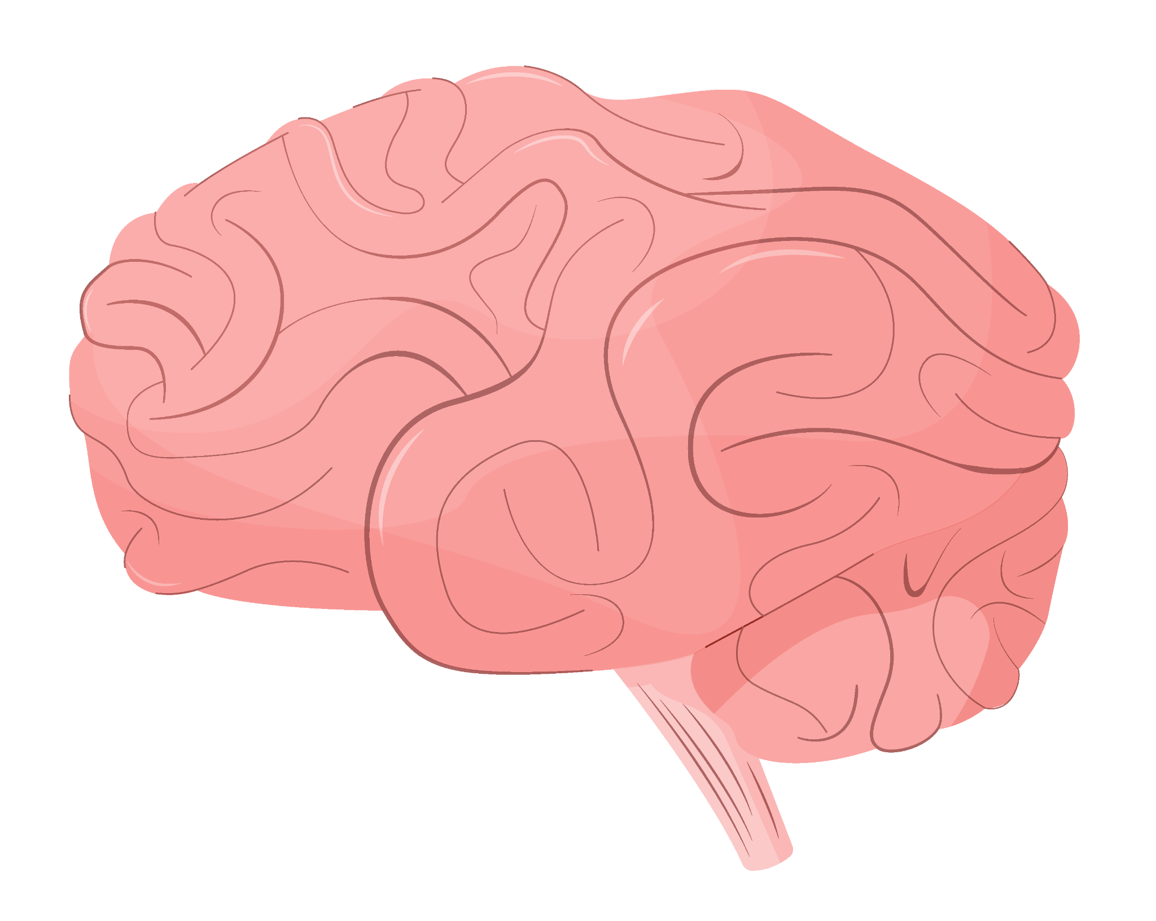
Purpose
What is Dementia?
Problem statement
Dementia is the impaired ability to remember, think, or make decisions that interferes with doing everyday activities.
Alzheimer’s disease is the most common type of dementia. Though dementia mostly affects older adults, it is not a part of normal aging.
Source
Can we use machine learning models such as logistic regression, random forests, and deep learning to predict dementia?

Slide 3
Methodology
Data collection
Exploratory Data analysis
Dataset #1 - Dementia Patient Health and Prescription Dataset (Kaggle)
Dataset #2 - Classification and Prediction of Dementia by SVM (Data.Mendeley)
Used Pandas and Spark to explore the Data
Predictive Models
Results validation
Deep Learning
Random Forest
Logistic Regression
Confusion Matrix
Classification Report
SHAP Values
Feature Importances

Slide 4
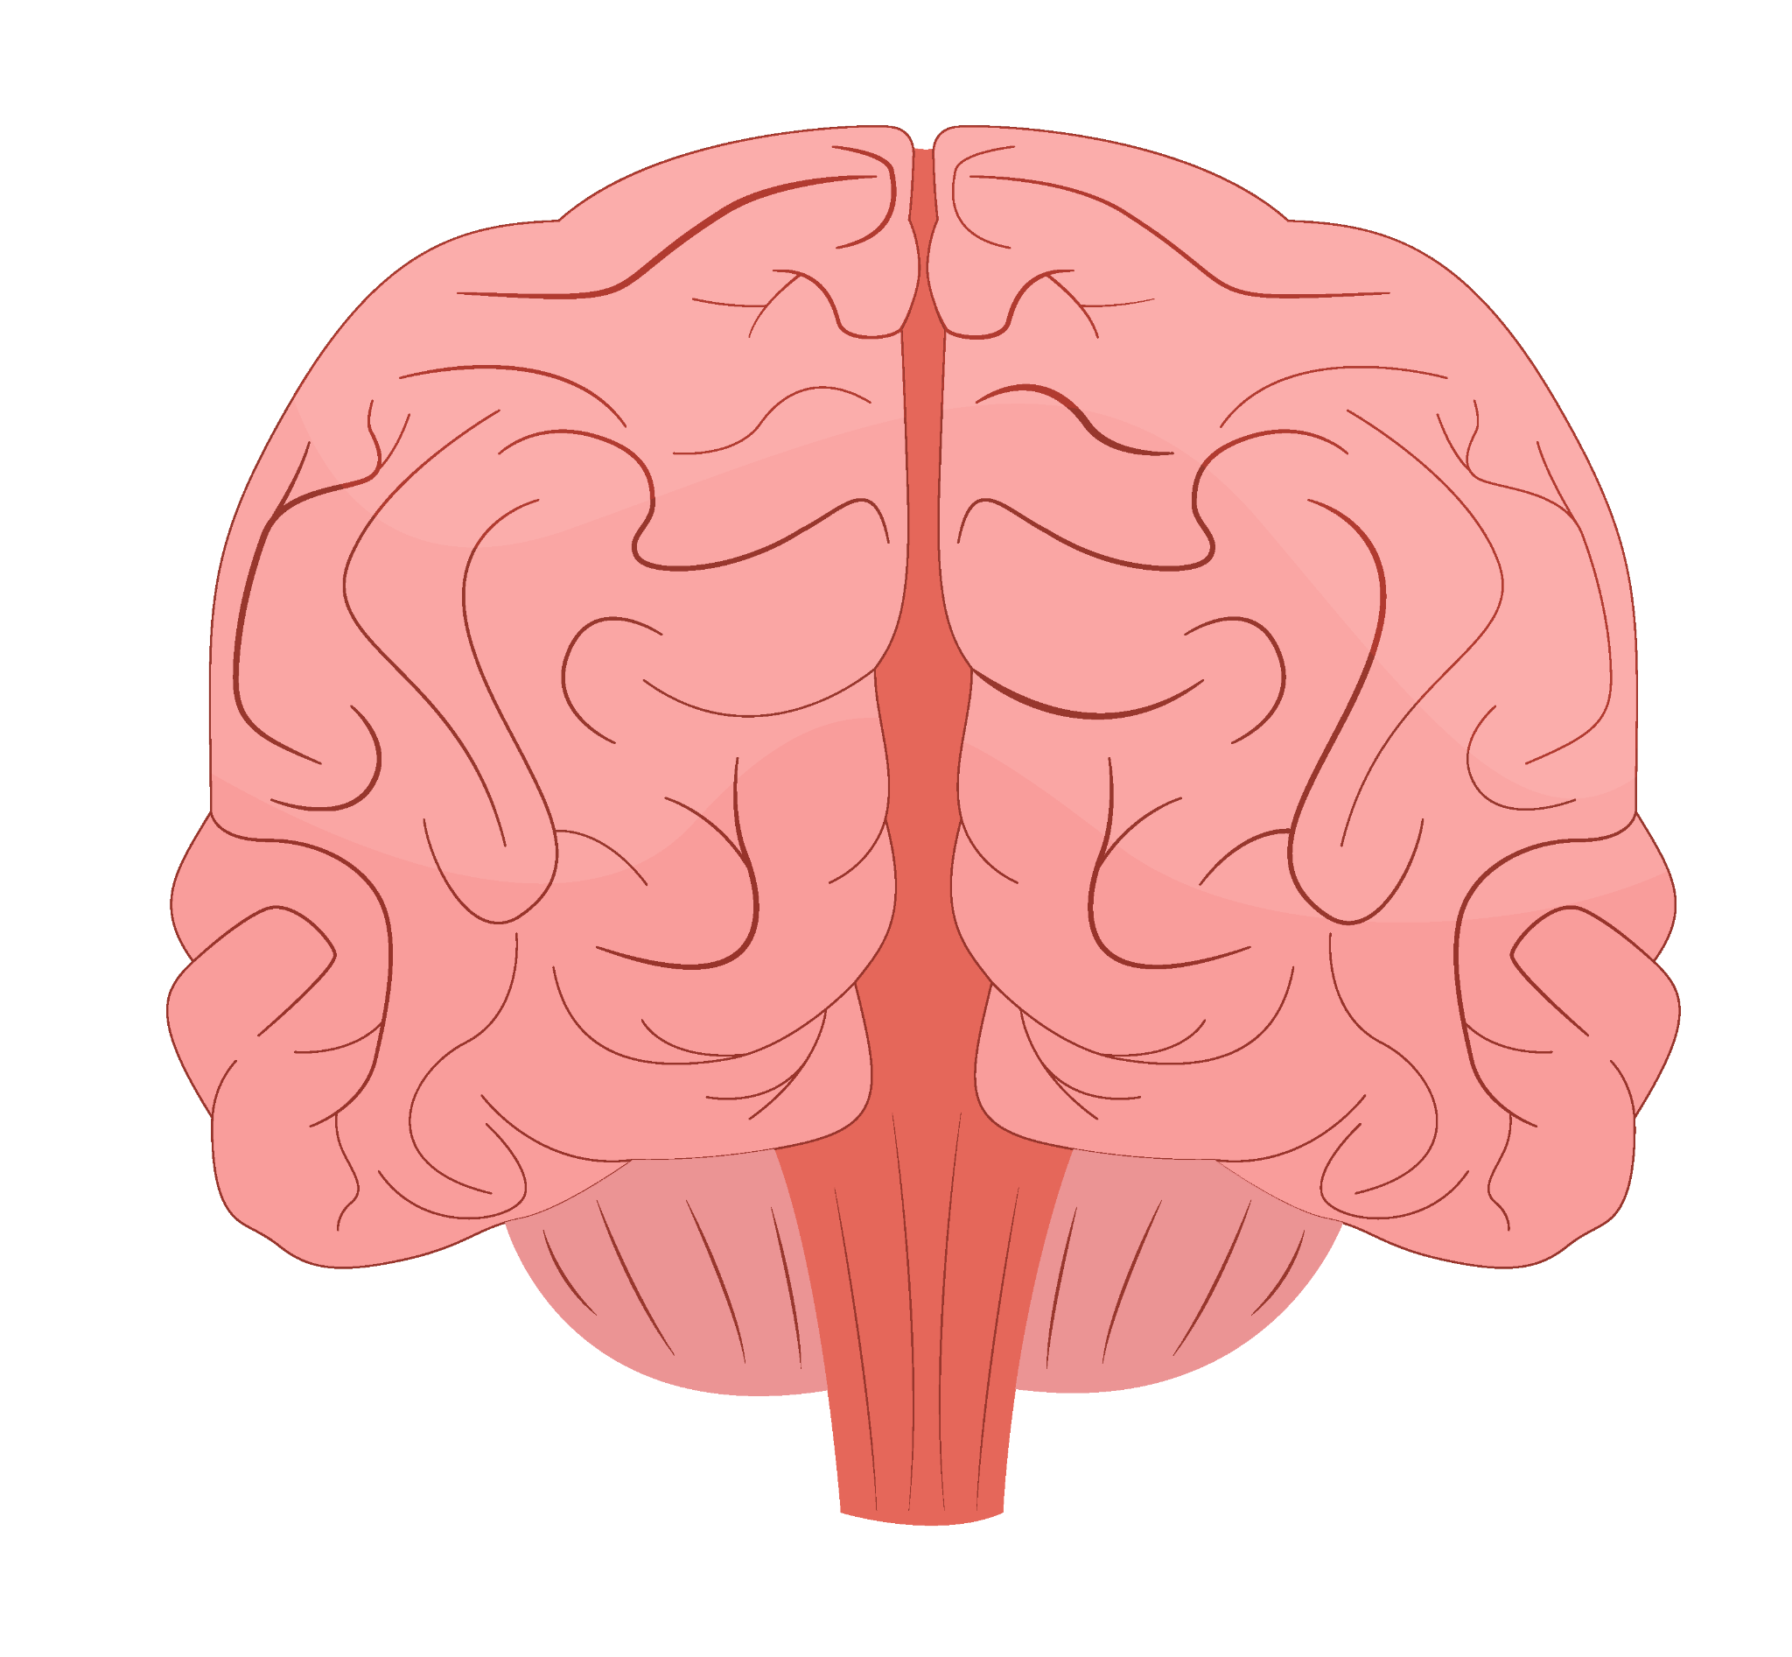
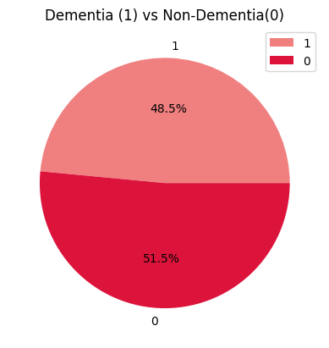
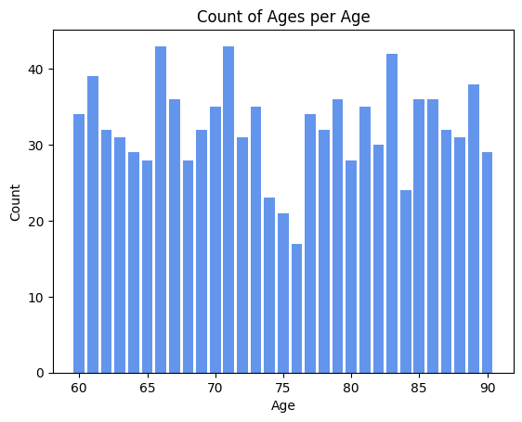
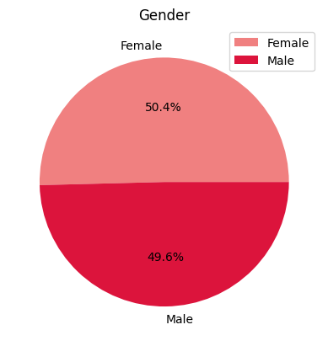
Overview (Dataset #1):
1,000 records:
Dementia Diagnosis
Age Range
Gender
Does not have dementia: 515
Has dementia: 485
60 - 90
Female: 504
Male: 496

Slide 5
Data Features (Dataset #1)
Column Name | Details
Alcohol Level | Alcohol Consumption Level
Heart Rate | Heartbeats per minute
Blood Oxygen Levels | Saturation of oxygen in the blood
Body Temperature | Celcius
Weight | Kilograms
MRI Delay | Time delay in obtaining an MRI Scan
Age | 60-90
Column Name | Details
Education Level | Highest level completed
Dominant Hand | Right / Left
Gender | Male / Female
Family History | Family history of dementia
Smoking Status | Smoker / Non-Smoker
APOE e4 | Presence of a gene variant associated with Alzheimer’s
Physical Activity | Level of physical activity in patient
Depression Status | Depressed / Not Depressed
Column Name | Details
Cognitive Test Scores | Scores from Cognitive Tests
Medication History | History or medication use
Sleep Quality | Patient quality of sleep
Chronic Health Conditions | Lists any chronic health conditions
Dementia | Demented / Not Demented

Slide 6
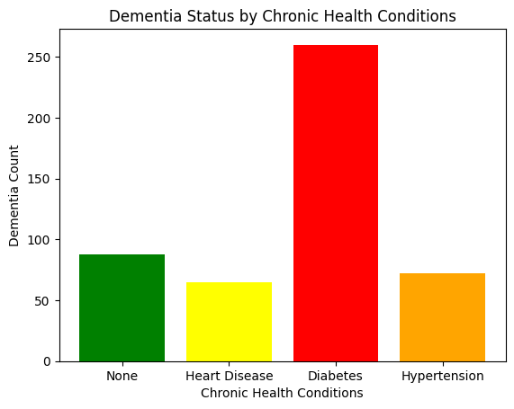
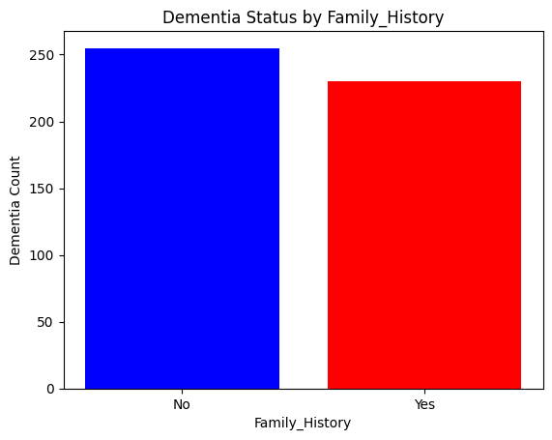
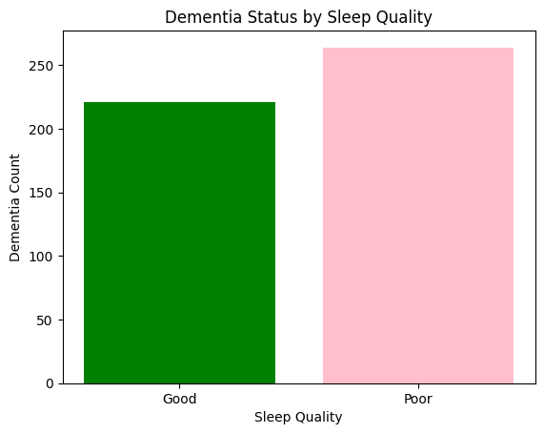
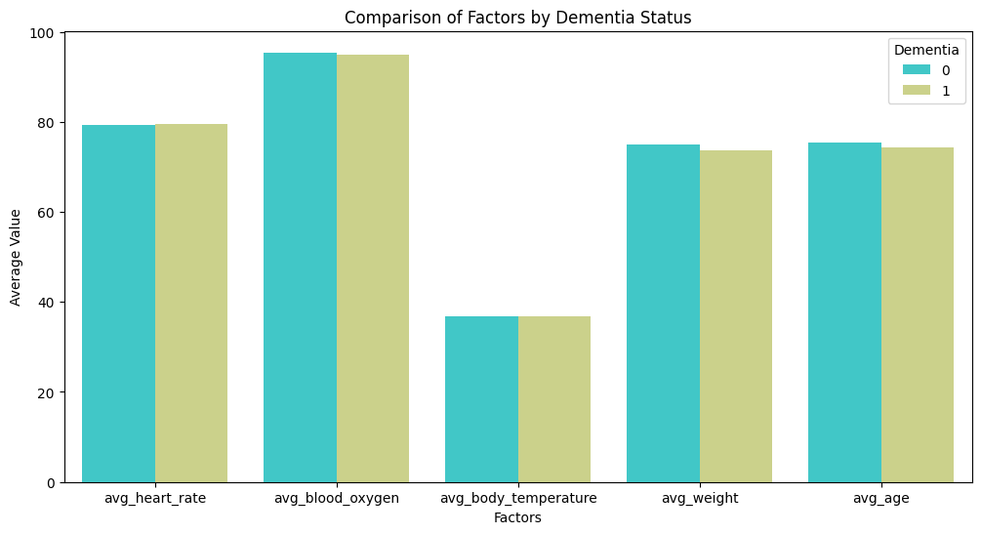
Data Exploration

Slide 7
Attempted Models:
Deep Learning Model
Random Forest Model
Logistic Regression Model

Slide 8
Deep Learning Model
Model: "sequential"
_________________________________________________________________
Layer (type) Output Shape Param #
=================================================================
dense (Dense) (None, 436) 13952
dense_1 (Dense) (None, 271) 118427
dense_2 (Dense) (None, 151) 41072
dense_3 (Dense) (None, 66) 10032
dense_4 (Dense) (None, 181) 12127
dense_5 (Dense) (None, 271) 49322
dense_6 (Dense) (None, 121) 32912
dense_7 (Dense) (None, 1) 122
dense_8 (Dense) (None, 1) 2
=================================================================
Accuracy: 99.20%
Loss: 0.024

Slide 9
Random Forest Model
What is Dementia?
Problem statement
Dementia is the impaired ability to remember, think, or make decisions that interferes with doing everyday activities.
Alzheimer’s disease is the most common type of dementia. Though dementia mostly affects older adults, it is not a part of normal aging.
Source
Can we use machine learning models such as logistic regression, random forests, and deep learning to predict dementia?

Slide 10
Logistic Regression Model
What is Dementia?
Problem statement
Dementia is the impaired ability to remember, think, or make decisions that interferes with doing everyday activities.
Alzheimer’s disease is the most common type of dementia. Though dementia mostly affects older adults, it is not a part of normal aging.
Source
Can we use machine learning models such as logistic regression, random forests, and deep learning to predict dementia?

Slide 11
Website:
Dataset #1
Dumiduni / Noelle

Slide 12
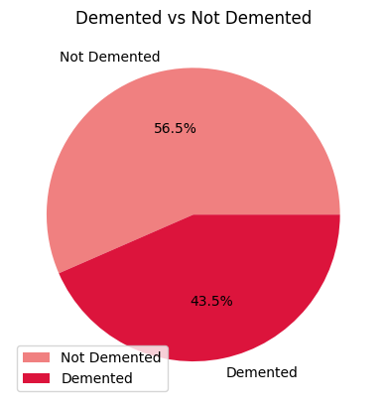
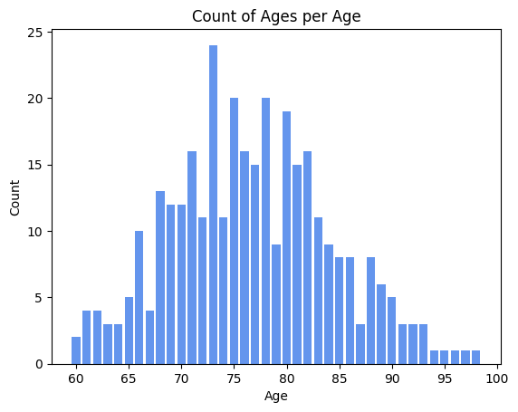
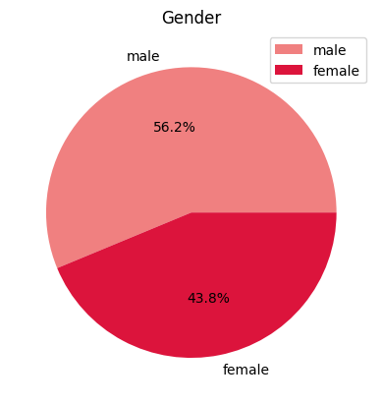
Overview (Dataset #2):
336 records:
Dementia Diagnosis
Age Range
Gender
Does not have dementia: 190
Has dementia: 146
60 - 98
Female: 147
Male: 189

Slide 13
Data Features (Dataset #2)
Column Name | Details
Group | Demented/ Non-Demented
Visit | Which visit the subject was scanned on
MR Delay | Magnetic Resonance Delay
M/F | Male / Female
Hand | Right /Left
Age | 60-96
EDUC | Highest grade completed
Column Name | Details
SES | Socioeconomic Status
MMSE | Mini-Mental State Exam
CDR | Clinical Dementia Rating
eTIV | Estimated Total Intracranial Volume
nWBV | Normalized Whole Brain Volume
ASF | Atlas Scaling Factor

Slide 14
Predictive Model:
Dataset #2
Dumiduni

Slide 15
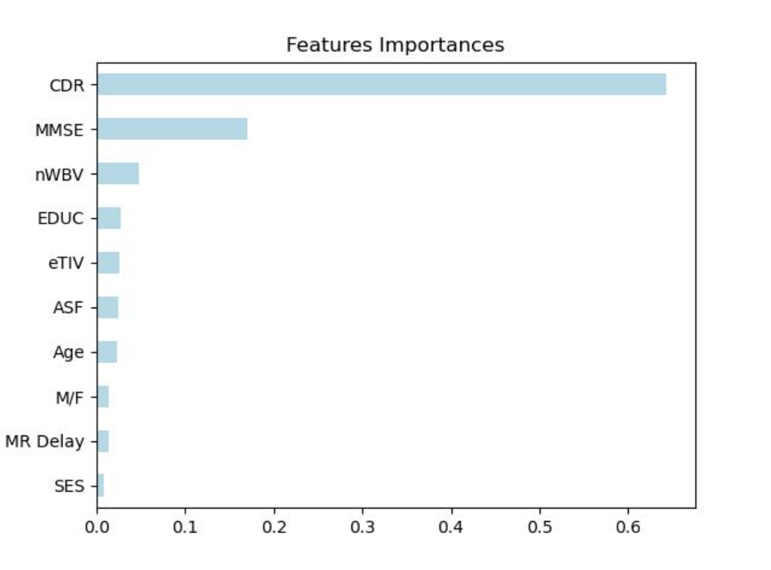
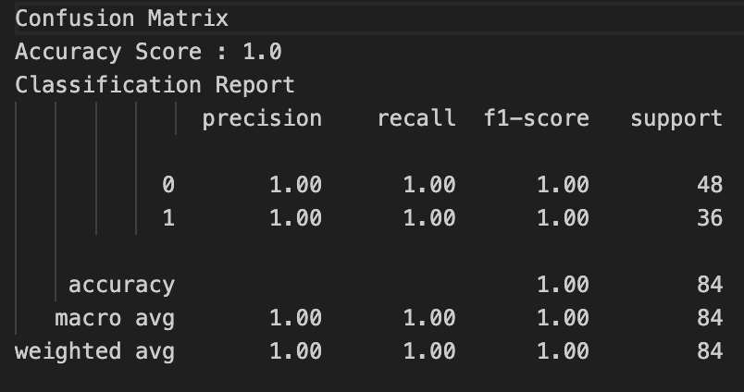
Predictive Model - Data with Rating Scales

Slide 16
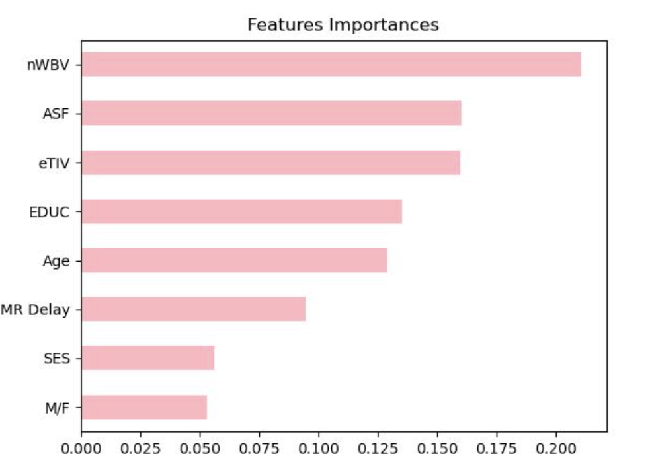
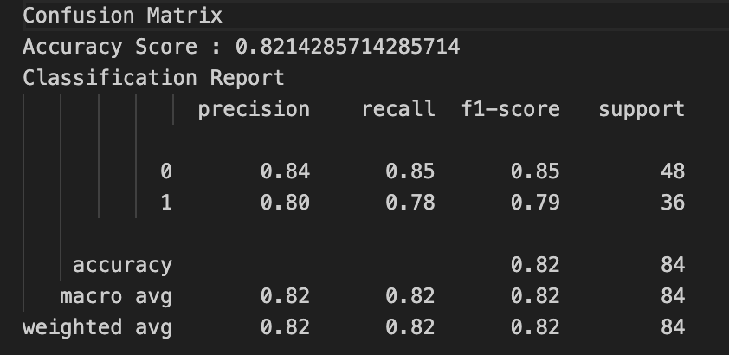
Predictive Model - Data with Rating Scales

Slide 17
Resources
Dataset #1
Dataset #2
Show all column names
Save Keras model summary
Keras tuner
Feature importance in random forests
Markdown-Table of contents
Template for slides

